Slide 2
CHANGE MANAGEMENT IN TURBULENT TIMES
November - 2012
Katz School of Business
Executive Education
Horst Abraham
Notes:
CHANGE IS ALL AROUND US
ORGANIZATIONS NEED TO CHANGE TO REMAIN RELEVANT.
WHAT ARE THE TWO STATEMENTS ABOVE MISSING?

Slide 3
Program Objectives
Culture Assessment: What characterizes our organization? Work unit?
Review values, norms, processes
Creating a Culture Profile.
Change leadership in review: competencies, characteristics.
Drawing a connection between ‘Organizational Energy’ and success.
The Change Process.
Telltales of high performance teams.
Examples of successful organizations.
Motivation 3.0
All change is self-change.

Slide 4

The ‘Lily Pad Riddle’
“On day one a large lake contains only a single small Lily pad. Each day the number of Lily pads doubles, until on the thirtieth day the lake is totally choked with vegetation. On what day was the lake half full?”
4

Slide 5
Context
“No century in human history has experienced so many social, economic and political transformations as the twentieth century. In the developed, free market countries – only one fifth of the earth’s population, but the model for the rest - living, working and transacting have undergone radical qualitative and quantitative changes, different and greater than any changes ever experienced in history before; different in the nature of problems we are facing, different in processes required to deal with them, different in structure and complexity ever experienced before.”
Peter Drucker
Notes:
FOR THOSE OF US SURROUNDED BY CHANGE, WHAT IS IT LIKE TO BE CAUGHT UP IN CHANGE, LET ALONE HAVING TO ORCHESTRATE CHANGE?

Slide 6
The last 150 years: A Three Act Drama
150 years
Conceptual Age =
Creator, Designer & Empathizer
Information Age =
Knowledge Worker
Industrial Age =
Factory Worker
Agricultural Age Farmer

Slide 7
What drives the ‘Conceptual Age’ Scenario?!
Asia -
Automation -
Abundance-

Slide 8
How do you answer these questions?
________________________________
Can someone overseas do it cheaper?
Can it be done faster?
Is what I am offering in demand in an age of abundance?

Slide 9
Time-Map: Profile…
Focus Area | 3 Years Ago | Now | 3-5 Years Out
Your Company
Your Competition
Your Job Responsibilities& Competencies

Slide 10
The New Normal
Leaving Rake Marks….
10

Slide 11
Culture Factoids
Culture is difficult to change unless you can diagnose it and measure it.
Congruence of organizational culture and leadership competencies leads to higher performance.
The current culture and the future culture may not be the same.
Culture change requires change leadership.
Culture change is often slow and painful.
It requires a systematic change process.
Notes:
Culture kills strategy

Slide 12
The Competing Values Model
Quinn and Cameron – University of Michigan
Clan - Collaborate
Adhocracy
Create
Hierarchy -
Control
Market - Compete

Slide 13
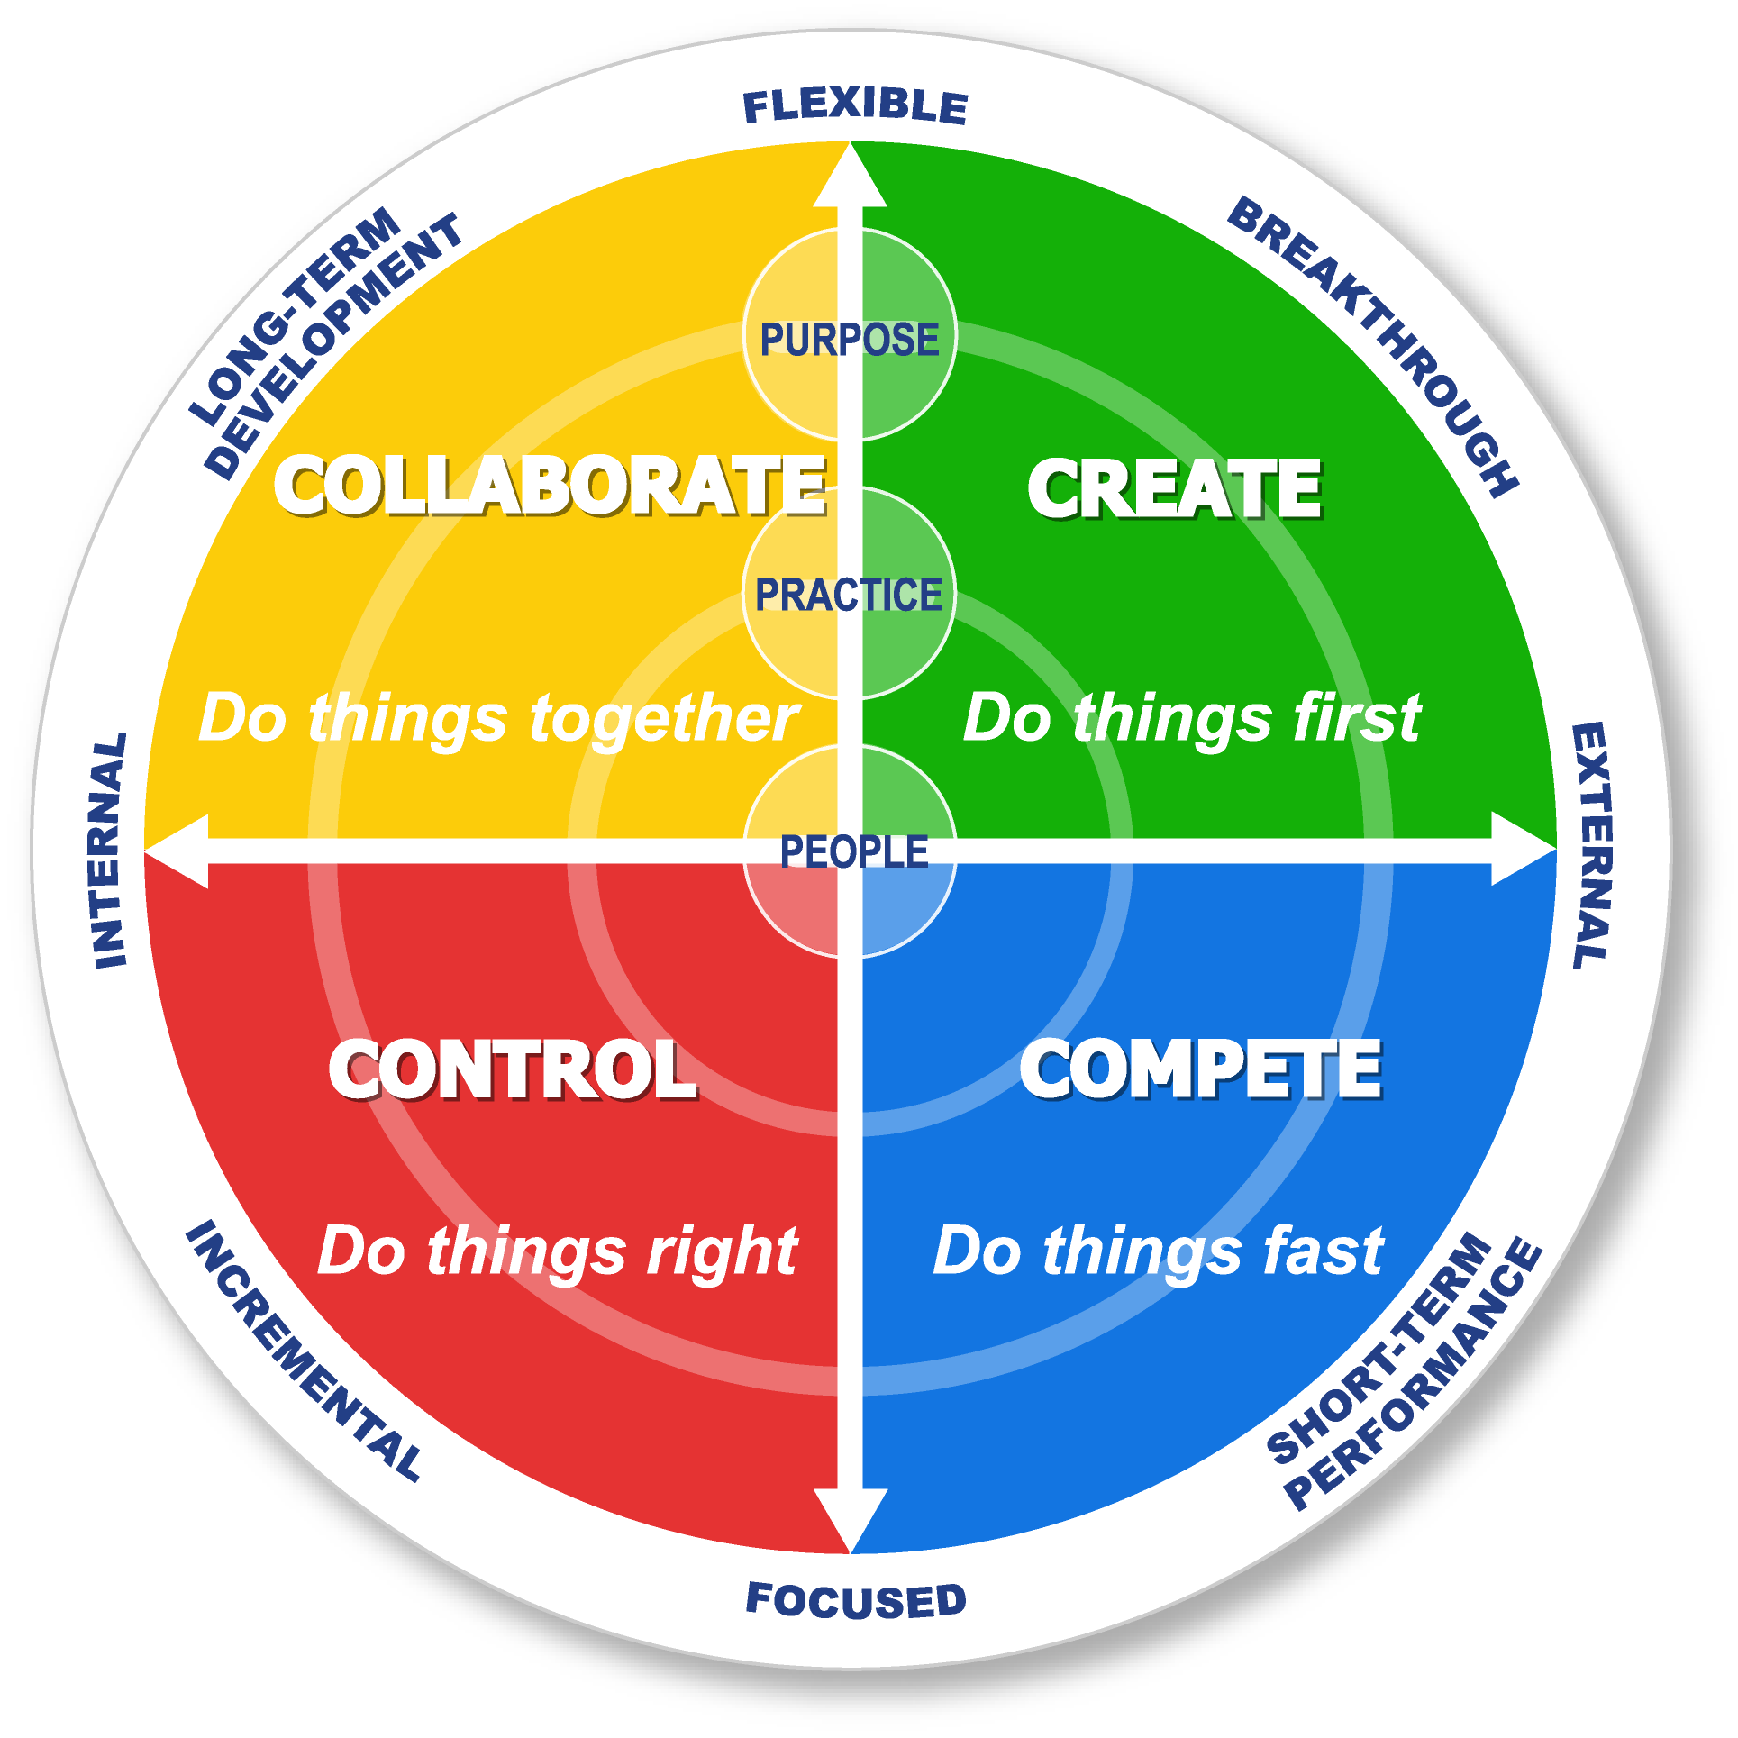
Adhocracy
Clan
Hierarchy
Market

Slide 14
The Competing Values Framework
Individuality
Flexibility
Long-term
Change
Culture Type: CLAN
Orientation: COLLABORATE
Leader Type: Facilitator
Mentor
Team builder
Value Drivers: Commitment
Communication
Development
Theory of Human development
Effectiveness: and high commitment
produce effectiveness
Culture Type: ADHOCRACY
Orientation: CREATE
Leader Type: Innovator
Entrepreneur
Visionary
Value Drivers: Innovative outputs
Transformation
Agility
Theory of Innovativeness, vision,
Effectiveness: and constant change
produce effectiveness
New
Change
Internal
Maintenance
External
Positioning
Culture Type: HIERARCHY
Orientation: CONTROL
Leader Type: Coordinator
Monitor
Organizer
Value Drivers: Efficiency
On Time
Consistency & Uniformity
Theory of Control and efficiency
Effectiveness: with capable processes
produce effectiveness
Culture Type: MARKET
Orientation: COMPETE
Leader Type: Hard-driver
Competitor
Producer
Value Drivers: Market share
Goal achievement
Profitability
Theory of Aggressively competing
Effectiveness: and customer focus
produce effectiveness
Fast
Change
Incremental
Change
Stability
Control

Slide 15
Organizational Culture Change Process
1. Individually, then in group, identify the gaps between your current and desired culture profile.
As a team, discuss what increasing or decreasing the scores in each quadrant means / does not mean.
Identify actions/behaviors that will close the identified gaps, thus moving from the current to the required culture. Consider intended as well as unintended consequences.
Contemplate what you personally can/will have to do to make the change happen?

Slide 16
Organizational Culture Profile
50
Clan
Adhocracy
50
40
40
30
30
20
20
10
10
10
10
20
20
30
30
40
40
50
50
Hierarchy
Market
16

Slide 17
Sample: Now _________ Required---------------
50
Clan
Adhocracy
50
40
40
30
30
20
20
10
10
10
10
20
20
30
30
40
40
50
50
Hierarchy
Market

Slide 18
Gap Analysis: What it means?!
Clan:
Increase/Decrease/Sam
What it means?!
Does not mean?!
Adhocracy:
Increase/Decrease/Same
What it means?!
Does not mean?!
Hierarchy:
Increase/Decrease/Same
What it means?!
What it does not mean?!
Market:
Increase/Decrease/Same
What it means?!
What it does not mean?!
18

Slide 19
Sample Culture Change Assessment Needs
CLAN CULTURE | ADHOCRACY CULTURE
Increase Decrease Maintain Means….. Survey and meet employee’s needs Promote teamwork and participation Foster better morale through empowerment Does not mean… Love-In Forgetting about stretch goals Operating with internal focus only | Increase Decrease Maintain Means… Encourage and celebrate risk-taking Tie rewards to innovation Clarify vision for organization Does not mean… Disregarding customer requirements Missing goals The latest of everything
HIERARCHY CULTURE | MARKET CULTURE
Increase Decrease Maintain Means…. Eliminate useless & interfering rules & procedures Eliminate unneeded reports and paperwork Give more power to regions Does not mean… Eliminating accountability & perf. Measurements Slacking off on production schedules Let inmates run the asylum | Increase Decrease Maintain Means… No margin, no mission Stop driving for numbers at all cost Constantly motivate our people Does not mean…. Ignoring the competition or shareholder Missing stretch goals and targets Missing profit projections and budgets.
19

Slide 20
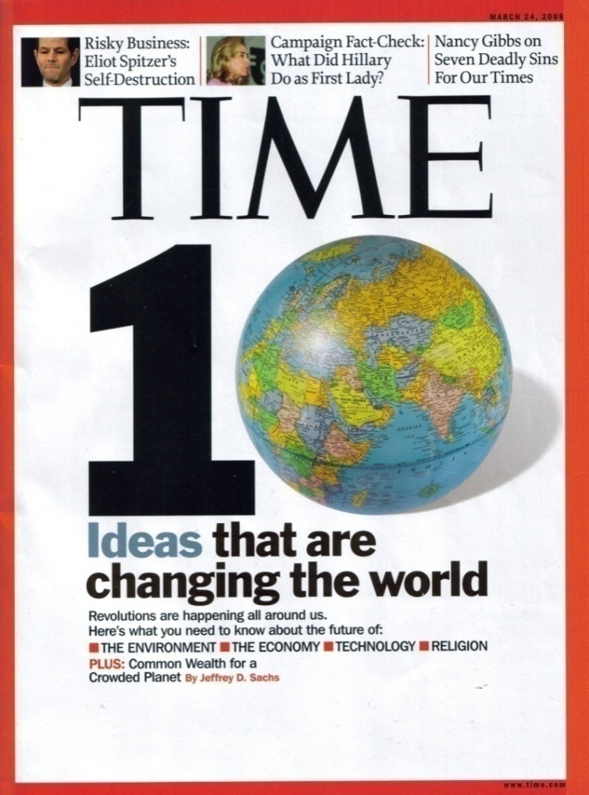
What’s ending? What’s beginning?!
The end of an era is typically marked by
increased control, scale, centralization
of power, and conflict.
The beginning of a new era is usually
marked by creativity, seismic change,
distribution of energy and power, and
conflict.
What’s ending in your world?
What’s beginning?
Notes:
20
20

Slide 21
Why Don’t Most Managers Think Creatively?
Reluctance to take risk, especially when short-term performance is at stake
The discomfort and associated fatigue of having to change her/himself.
The potential psychological cost of changing one's mind.
The lack of skill to manage change.
Marketing Metaphoria by Zaltman & Zaltman
Notes:
21

Slide 22

Resilience and Change
Means to achieve resilience:
  Feeling of inclusion.
  Understanding the change process.
  A sense that the change process is well managed.
  Having a good sense of why the change is happening.
  Being given relevant information in a timely manner.
  Group members have a sense of control over process/outcome.
  Understanding the cost of the disruption.
  Anticipating resistance and working to mitigate it.
  Understanding a group’s capacity to integrate change on all three levels:
      Micro Changes
      Organizational Changes
      Macro- Changes
22

Slide 23
Structural Tension / Structural Oscillation
1. Organizations ‘advance’ when ‘structural tension’ dominates.
2. Organizations ‘oscillate’ when ‘structural conflict’ dominates.
Organizations ‘advance’ when reality is seen as it is, and
Strategic intent, values, processes, rewards and commitments
are in alignment.
Organizations ‘oscillate’ when one or more of the following
factors are out of alignment: Strategic intent, organizational
values, processes, rewards and commitments. Such
organizations fail to see the systemic interdependency between
these factors, thus failing to impact the system.

Slide 24
Limited Capacity to cope with Change
Future shock usually occurs because of the aggregate impact of several changes. Most of us have the capacity to deal with 600 - 700 stress points:
Assimilation
Points Used
100
75
Macro Change: We all are impacted
Micro Change: How I am impacted
800
700
500
400
300
100
200
75
100
Organizational Change: Impact

Slide 25


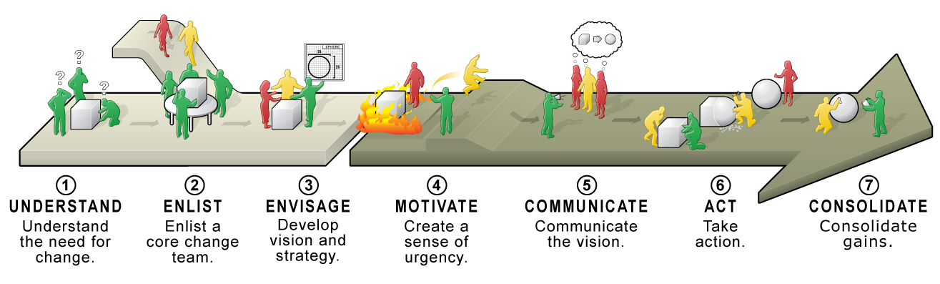
Setting the Stage for Change
Build commitment with stakeholders with a two phase, seven step approach
Align
Execute
ALIGN KEY STAKEHOLDERS
EXECUTE ACROSS ORGANIZATION
Intro
SIM - Analyze
Case & Theory
Case & Theory
SIM - Plan
SIM - Implement
Debrief
Notes:
ExperienceChange
Change Management Simulation
25

Slide 26
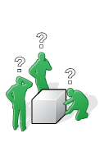
1. Understand
Gather information
Interviews with leaders, managers, and front-line employees
Speak with customers and non-customers
Benchmark competitors and other organizations.
Identify the Problem
Determine root causes and not symptoms.
If your diagnosis is wrong, then everything that follows
will be off track
Share information with key stakeholders
Create alignment with key stakeholders by sharing an honest assessment of the current state.
Intro
SIM - Analyze
Case & Theory
Case & Theory
SIM - Plan
SIM - Implement
Debrief
Notes:
ExperienceChange
Change Management Simulation
26

Slide 27

2. Enlist
Stakeholder Mapping
  Assess stakeholder support and resistance to get a snapshot of the organization’s readiness to change
Select Change Agent
  Visioning, Motivating, Empowering, Managing
Build Change Team
  Leadership, Position power, Expertise, Credibility, Management *
* Source: John Kotter, Leading Change
Notes:
ExperienceChange
Change Management Simulation
27
In the simulation, you will be challenged to put Transition structures into place. This includes selecting a project leader and building a change team.
A good means of diagnosing pockets of resistance and support prior to building Transition structures is building a Stakeholder Map where individuals’ support for change is assessed.

Slide 28
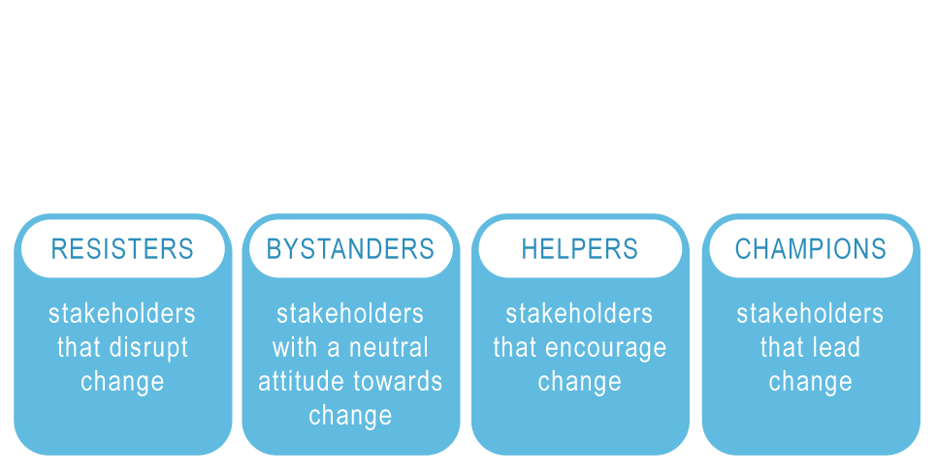
2. Enlist – Assess Resistance
Intro
SIM - Analyze
Case & Theory
Case & Theory
SIM - Plan
SIM - Implement
Debrief
Notes:
ExperienceChange
Change Management Simulation
28
It is helpful to think about four categories along the resistance-support spectrum.

Slide 29
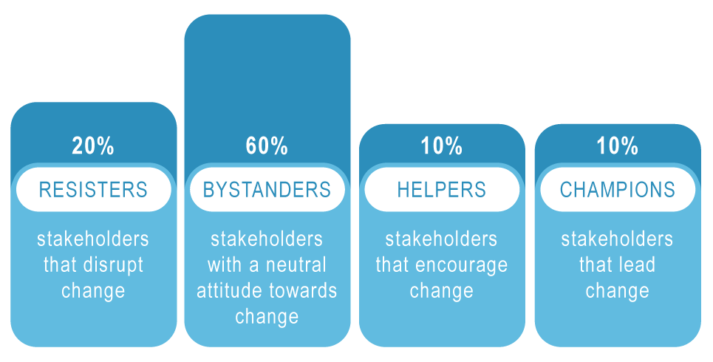
2. Enlist – Assess Resistance
Intro
SIM - Analyze
Case & Theory
Case & Theory
SIM - Plan
SIM - Implement
Debrief
Notes:
ExperienceChange
Change Management Simulation
29
Although the distribution of resistance and support will vary depending on the change and the context, it often will follow the same pattern as the new-product adoption curve (i.e. normal distribution)

Slide 30

3. Envisage
Develop a vision
  Describes “where you want to go”
  Tangible, Desireable, Feasible & Flexible, Focused & Simple
Develop a strategy
  Describes “how you’ll get there”
  Provides a framework of operational decisions
Intro
SIM - Analyze
Case & Theory
Case & Theory
SIM - Plan
SIM - Implement
Debrief
Notes:
ExperienceChange
Change Management Simulation
30
In the simulation, you will not be asked to script a vision for Global Tech. However you will have to decide how Global Tech designs its Vision and Strategy.

Slide 31
Implement Change
Move from planning at a project level to execution
Execute
ALIGN KEY STAKEHOLDERS
EXECUTE ACROSS ORGANIZATION
Intro
SIM - Analyze
Case & Theory
Case & Theory
SIM - Plan
SIM - Implement
Debrief
Notes:
ExperienceChange
Change Management Simulation
31

Slide 32
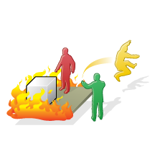
4. Motivate
Create dissatisfaction with status quo:
  Share information
  Establish clear expectations and
  set ambitious stretch targets
  Identify a crisis
  Communicate honestly – What are the implications of status quo?
Intro
SIM - Analyze
Case & Theory
Case & Theory
SIM - Plan
SIM - Implement
Debrief
* Source: John Kotter, Leading Change
Notes:
ExperienceChange
Change Management Simulation
32
Share information - objective data is needed to build a foundation for the business case.
Set ambitious stretch targets - ‘raising the bar’ can help motivate employees to act and recognize that achieving higher goals cannot be done under current systems and structures. Set clear expectations
Align your reward system and structure - at first by recognizing efforts to change and reinforcing them, then through ensuring tight alignment of formal reward system (including promotional) and structure Example:
Identify or create a crisis - Kotter points to a CEO who arrived at a fairly good company that he wanted to make great. In order to remove the complacency that existed, he allowed department heads to overspend on their budgets to the tune of $1B so that he could then point to a looming crisis and motivate folks to change. This is somewhat extreme.
Communicate Honestly - in the simulation, participants will have to avoid the natural paternalistic tendency to protect employees from concern about the future. Hiding scary information from employees can be counterproductive.

Slide 33
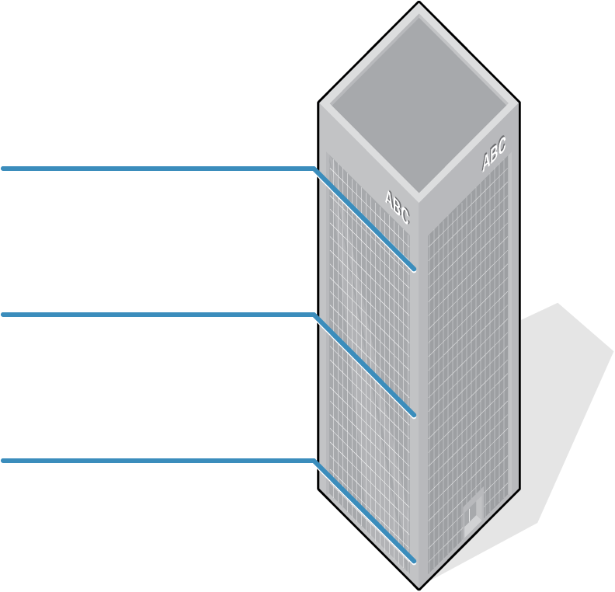
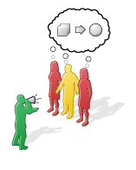
5. Communicate - What
What is best for the
COMPANY
What is best for the
DEPARTMENT / TEAM
What is best for
ME / YOU
Intro
SIM - Analyze
Case & Theory
Case & Theory
SIM - Plan
SIM - Implement
Debrief
Notes:
ExperienceChange
Change Management Simulation
33

Slide 34
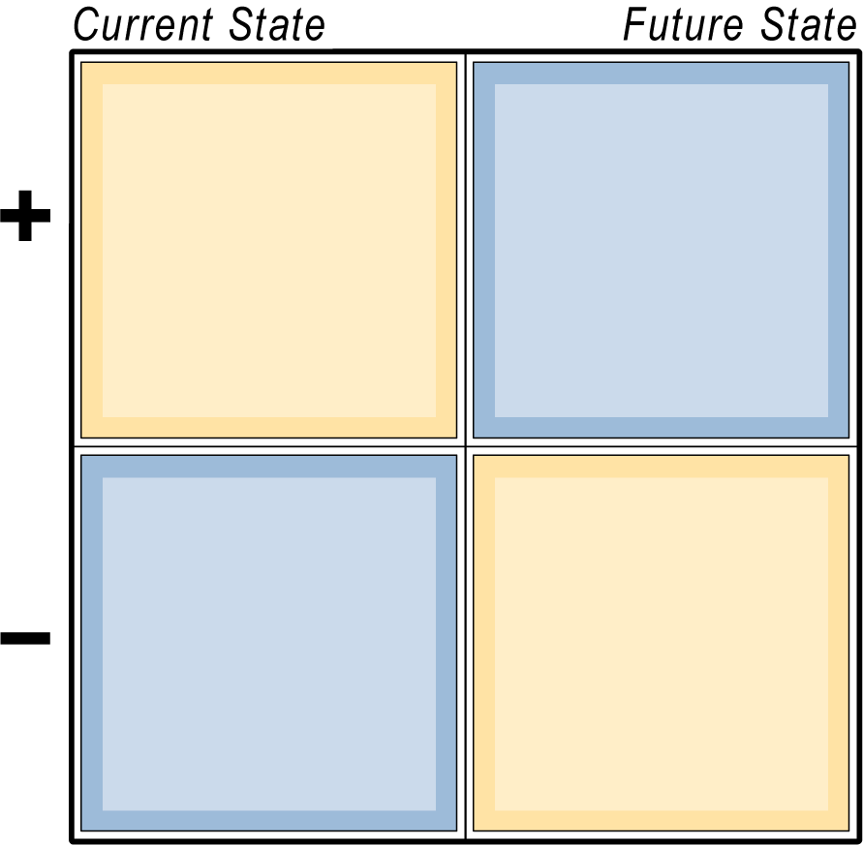
5. Communicate - When
Celebrate our success in the current state as we evolve.
The future can be better than the present.
4
2
1
3
Communicate the negative about today. Create a sense of urgency.
There will be challenges along the way and it won’t be perfect.
Intro
SIM - Analyze
Case & Theory
Case & Theory
SIM - Plan
SIM - Implement
Debrief
Notes:
ExperienceChange
Change Management Simulation
34

Slide 35
5. Communicate - how
What’s the most effective way to communicate?
Face-to-face
How much communication is enough?
Say it, say it, say it again
Multiple Methods
KISS, Metaphors / Analogies
Make it involving
Leadership by example
Intro
SIM - Analyze
Case & Theory
Case & Theory
SIM - Plan
SIM - Implement
Debrief
Notes:
ExperienceChange
Change Management Simulation
35

Slide 36
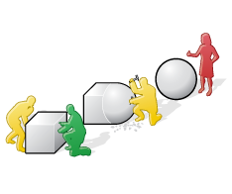
6. Act
Make structures compatible with the vision
Provide the training employees need
Align practices, policies, systems
Generate and publicize short-term wins
Deal with managers who undercut needed change
Intro
SIM - Analyze
Case & Theory
Case & Theory
SIM - Plan
SIM - Implement
Debrief
Notes:
ExperienceChange
Change Management Simulation
36

Slide 37

7. Consolidate
Use increased credibility to change policies, structures, and systems that don’t support the vision
Hire, promote, and develop employees who can implement the vision
Reinvigorate the process with new projects, themes, and change agents
Intro
SIM - Analyze
Case & Theory
Case & Theory
SIM - Plan
SIM - Implement
Debrief
Notes:
ExperienceChange
Change Management Simulation
37

Slide 38
The model: How does it work?
Decision Effectiveness =ƒ(Timing, Sequencing, Execution)
Timing = how well were tactics matched to the appropriate stage (e.g. were ‘urgency’ tactics implemented when the organization was in need of urgency?)
Sequencing = were tactics preceded with associated steps (e.g. were team implementation tactics preceded with ‘teams training’)
Execution = were critical tactics executed well (e.g. did the steering committee have a good balance of position power, expertise, credibility, leadership skills, & management skills)

Slide 39

Examples of change practices….

Slide 40
Best Practice 1: Get the right people on the bus!
Select a diverse team of ‘excellent’ imagineers and rid yourself of people who hold the team back.
Get cynics and doubters out of the way, but keep skeptics.
Notes:
40

Slide 41
Best Practice 2: Accelerate the Failure Rate
There is no learning without mistakes.
Fail often and ‘early’ to succeed sooner!

Slide 42
Best Practice 3: ‘20% Time with training wheels.’
Allow your employees one fifth of their work time working on projects they want to work on.
If you are worried about the wisdom of 20% time, start with 10% - that is one afternoon of an entire work week, and try it for 6 months.
By creating an island of autonomy you will help people act on their great ideas of how to generate a new product idea, a better or different process in the work flow, a better back office process. Who knows, someone might come up with the next Post-It invention.

Slide 43
Best Practice 4: ‘Encourage Peer to Peer Rewards’ –
(Now That Rewards)
At any point, without asking permission, any employee can award a $50.-
bonus to any of their colleagues for making something better, faster, different, easier that benefits the greater good.
Because it is given from someone other than a boss, it carries a special meaning to the recipient.
This kind of peer acknowledgement generates a powerful sense of extended accountability.
Notes:
43

Slide 44
Best Practice 5: Conduct an ‘Autonomy Audit’
This is especially helpful in work environments where a good portion of people’s jobs is monotonous and routine like.
The aim is to give people as much wiggle room as is possible, to turn work into ‘play’. Ask each person on your team to respond to the following four questions, using a scale from (low) 0 to 10 (high).
How much autonomy do you have over the tasks you do at work?
How much autonomy do you have over the time at work?
How much autonomy do you have over who is on your team you work with?
How much autonomy do you have over the technique you work with?
Make sure all responses are anonymous, then tabulate the results. An overall
autonomy rating of 27 is not bad, yet watch also the individual averages, as
each tells a story that might desire a response, conversation or adjustment.
Providing the results back to your employees, ask for ideas of how to enrich the
job situation.
Notes:
44

Slide 45
Best Practice 6: Create the right work environment
Projects: Create projects that provide opportunities for innovation practitioners to experiment.
People: Create a community of highly practiced innovators.
Place: Create a place for these innovation practitioners to work together.
Practices: Create new practices and forums to share them.

Slide 46
Best Practice 6: ‘Three Steps to give up Control’
Bosses who are control oriented hate relinquishing control, even though
they know about the benefits of doing so, or they do not know what to
substitute control with. Here are three ways to exercise a different kind of
leadership:
Involve people in goal setting : Research shows that people are far more invested in achieving goals when they were party to setting them. It may surprise you to find that people often set the bar higher than you would.
Use non-controlling language: Instead of using words like ‘must’ or should’, use words like ‘think about’ or ‘consider’. Language is very powerful and is able to help turn compliance into full engagement and commitment.
Hold Office Hours: Give people a chance to come to you, on their volition, with ideas and concerns. Conversations with employees should not just be about work and performance, but also about their thoughts and feelings. To make that possible, schedule ‘Office Hour Visit Time’, or else you will never have time.

Slide 47
Best Practice 7: ‘Hold a Daily 5 Minute Fractal Session’.
Hold a 5 minute standing ‘Fractal’ session in which you collect , in quick go
around, ideas that respond to the following question:
‘How can we do this (fill in the blank) better today?’
Select as the target for your question any process, situation or project you wish to improve. The repeat nature of holding such short morning meetings primes the pump for people to think about possibilities.
Just think of it: every day a small improvement on a project or process leads over time to significant change.
Such a process mobilizes people’s creative thinking and commitment.
Notes:
Queen Isabella

Slide 48
Best Practice 8: Promote ‘Goldilocks’ for work teams
To get your team to operate in a FLOW mode, create project opportunities that
Are neither too hard, nor too boring, thus enabling teams to experience the delicious sense of FLOW.
Begin with a diverse team in which people stimulate each other and learn
from each other so they are not homogeneous in terms of skills and background.
Make this group a ‘no competition’ zone and aim to unleash enthusiastic collaboration.
Try a little task shifting if someone is bored with his current job. Also, see whether you can encourage team members to train others in what they do really well, fostering better understanding and unleashing the ‘Sawyer Effect’.
Animate with ‘purpose, and do not motivate with rewards. Common cause and purpose that matters galvanizes a team more than any reward you can offer.

Slide 49
Best Practice 9: Make your next off-site a Fed-X Day.
1. Begin with a diverse team with which you deliberately avoid homogeneity, so people can learn from each other and generate creative ideas.
Make this group a ‘no competition’ zone and aim to unleash enthusiastic collaboration.
Try a little task shifting if someone is bored with his current job. Also, see whether you can encourage team members to train others in what they do really well, fostering better understanding and unleashing the ‘Sawyer Effect’.
Animate with ‘purpose, and do not motivate with rewards. Common cause and purpose that matters galvanizes a team more than any reward you can offer.

Slide 50
Best Practice 10: Your own ideas here:
________________________________________________________________________________________________________________________________________________________________________________________________________________________________________________________________________________________________________________________________________________________________________________________________________________________________________________________________________________________________________________________________________________________________________________

Slide 51
An example of a GREEN company:
IDEO
Palo Alto
Design Firm
Notes:
51

Slide 52

How Does IDEO Jumpstart Innovation ?
What are IDEO’s innovation practices?
What is the role and style of the leader?
What can you learn from IDEO to simply and rapidly make happen in your firm?
__________________________________________________
__________________________________________________
__________________________________________________
__________________________________________________
__________________________________________________
__________________________________________________
__________________________________________________
Notes:
52

Slide 53
LEADERSHIP
AUTHORITY
We encounter a problem by using the terms interchangeably.

Slide 54
The Leadership Dilemma:
Organizations seek stasis.
While most managers and leaders invest time and effort keeping everything on an even keel, change leaders are required to ‘disturb’ the system, forcing it to re-define itself. (Provocative Competence)
Routine problem solving (Technical challenge)
and leading fundamental change (Adaptive challenge) require different leadership and different solutions.

Slide 55
Technical Challenge Adaptive – Challenge
* Challenge is known * Challenge not known
* Skills known and available * Skills need to be learned.
* Locus of Solution: Expert * Locus of Solution:
Learning/Process.
* Process: Disciplined * Process: Messy- casualties.
* Communication: directive * Communication: noisy,
inquiry.
* Leadership: Tell’ * Leadership: ‘Ask’

Slide 56
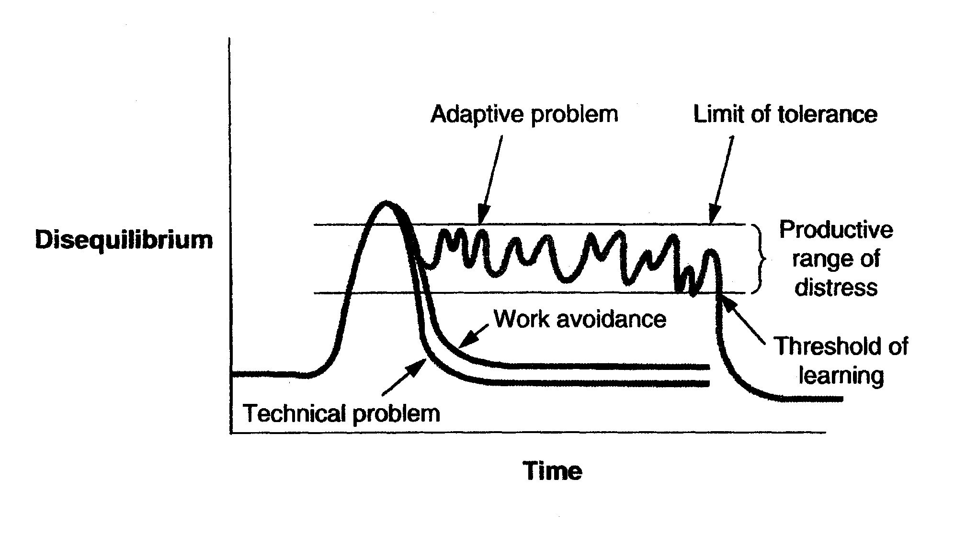
Regulating the Disequilibrium
Ron Haifetz - HSG
56

Slide 57

Work Avoidance Mechanisms
1. Denial
2. Diversions: attending to the urgent, not the important.
3. Laying blame: finger pointing.
  – Externalizing the enemy.
  – Attacking authority.
  – Neutralizing the (adaptive) leader because of rising discomfort
with the exposure to the unknown, the discomfort of having to learn your
way forward. There is a tendency to hold on to the past or searching for
the task expert, even though there is none.
Phony solutions:
  – Re-structuring.
  – Forming committees.
  – Using a ‘technical’ solution to an ‘adaptive’ problem or visa versa.
Sterile conflict:
  – No listening, no curiosity, no creative engagement
  – Sacred cows,

Slide 58
Adaptive Leadership Competencies:
1. Get on the Balcony.
2. Identify the nature of the challenge.
3. Disturb the system.
4. Give work back to the people.
5. Detect signs of work avoidance.
6. Regulate the disturbance.
7. Protect the dissident.
Winston Churchill: “They are not ready for leadership yet”.
Notes:
INTEL: ANDY GROVE: ONLY THE PARANOID SURVIVE
ADAPTIVE CHALLENGES ARE USUALLY CHALLENGES OF HUMAN COMPLEXITY. CULTURE – BEHAVIOR ISSUES –
MOKIDA
CHRYSLER; CFO DECLARED BANKRUPCY TO MOVE THE CULTURE
CULTURE EATS STRATEGY –
CULTURE RESILIANCE
LOU ROSS -

Slide 59
Research - Heliotropic Effect
Positive Emotions & Imagery
Approach-Goals vs. Avoidance-Goals
Positive Relationships
Focus on Strengths
Positive Energy
High Collective EQ/IQ
Trust – Open & Honest Communication
Risk Taking
SOURCES: See Cameron & Lavine, 2006; Cameron, 2007 for references

Slide 60
High Performance Team Communication
SOURCE: Losada & Heaphy, 2003
Team Performance
High Medium Low
Positive Statement Ratio 5.6 to 1 1.8 to 1 .36 to 1
(supportive, encouraging, appreciation)
Inquiry/Advocacy Ratio 1.1 to 1 .67 to 1 .05 to 1
(asserting versus questioning)
Others/Self Ratio .94 to 1 .62 to 1 .03 to 1
(internal versus external focus)
Connectivity Average 32 22 18
(mutual influence, assistance)

Slide 61
Positive Energizers
Those who positively energize others are higher performers. Position in the energy network is 4 x the predictor of performance compared to position in the influence network.
Positive energizers tend to enhance the work of others. People who interact with or are connected to energizers perform better.
High performing firms had three times as many positive energizing networks than low performing firms.
SOURCE: Dr. W. Baker

Slide 62
Describing Negative Energizers
They mostly see roadblocks or are critical of others.
They don’t create opportunities for others to be successful.
They are often inflexible in their thinking.
They don’t show concern for those around them
They often don’t come through on commitments
They just get louder when people don’t listen
They leave a negative emotional wake.

Slide 63
Why Don’t Positive Factors Get More Attention?
A systemic bias: Negative factors are more powerful / important than positive factors.
People are more affected by one negative event than by one positive or happy event (for example, losing $1000 compared to winning $1000).
People are more affected emotionally and do more mental processing from a single negative piece of feedback than from a single positive piece of feedback. (Amygdala Hijack!)
Evolutionary theory suggests why: If people ignore negative information, it could cost them their lives. If they ignore positive feedback it only causes regret.

Slide 64
Recognize productive team behavior patterns…
Teams on the way down | Teams on the way up
People shield those in power from unpleasant facts, fearful of penalties and criticism for shining the light on the rough realities. | People bring forth grim facts to be discussed; leaders do not criticize those who expose harsh realities.
People assert strong opinions without providing data, evidence or a solid argument. | People bring data, evidence, logic and solid arguments to discussions.
The team leader has a very low question to statement ratio, avoiding critical input and/or allowing sloppy reasoning and unsupported opinions. | Team leader use Socratic style, using a high question to statement ratio, challenging people, and pushing for penetrating insights.
Team members acquiesce to a decision, but don’t unify to support it, or worse, undermine the decision afterwards. | Team members unify behind a decision made, then work to make the decision succeed, even when they vigorously disagreed with it.
Team members seek as much credit for themselves, yet do not enjoy the confidence and admiration of their peers. False peace. | Team members credit others for successes, and enjoy the confidence and admiration of peers.
Team members argue to look smart or to further their own interests rather than argue to find the best answers to support the overall cause. | Team members argue and debate, not to improve their personal position, but to find the best answers to support the overall cause.
Team members often fail to achieve exceptional results and blame other people or external circumstances for setbacks, mistakes or failures. Team conducts autopsies with blame, rather than seeking collective wisdom. | Team conducts autopsies without blame, mining wisdom from even painful experiences. Team members deliver exceptional results, yet in the event of a set back accept full responsibility and learns from mistakes.

Slide 65

“Empowerment is . . . .”
Notes:
65

Slide 66
‘Who is empowered?’
Rank order the following five categories of individuals in terms of the amount of empowerment each is likely to experience during their normal daily lives.
  ___ A new Army recruit
  ___ A new manager in your own organization
  ___ A prisoner in jail
  ___ A middle manager in your organization
  ___ A homemaker with children
Notes:
66

Slide 67
Empowerment 1:
Using a scale from 1 (small degree) to 7 (large degree) please indicate the extent to which you believe the person in each example is acting in an empowered manner:
  1. A middle manager came up with a new system for working with remote locations. The system was a threat
  what was currently a highly centralized operation. Careful analysis showed that the change would result in
  lower cost, increase quality and better coordination. Furthermore the individual knew, intuitively, that the
  change was ‘right’. In making his initial proposal, he received discouraging responses from those above and
  below. He nevertheless made a long term commitment to slowly sell his idea.
2. A newly assigned middle manager, attending her first meeting with her new group, listened to a proposal made by her boss. Given her considerable experience with a similar subject at her previous location, she was quite knowledgeable of the shortcomings of the proposal being made. She therefore made a bluntly honest, but constructive, assessment of the shortcomings of the proposal.
3. A CEO, known to sometimes act as a tyrant, decided that the activities in a certain function should be expanded. The analytic task fell on a middle manager, five layers down in the hierarchy. The manager eventually concluded that the function should be eliminated. His immediate superior told him to ‘redo’ the analysis. After much soul searching, the man turned in the report recommending the elimination. His superiors then decided that the man would make the presentation directly to the CEO. He agreed to do so.
4. Some years ago a plant manager was told that a new product must be launched. After an analysis, it was concluded that the only way the project could be accomplished was to promise life-long employment to the union. This was a radical idea that would clearly not be approved at corporate headquarters, nor by his direct superior. The plant manager made the promise and proceeded. The project ended up being successful.

Slide 68
The Four Keys to Empowerment:
CONTINUOUS PARTICIPATION & INVOLVEMENT | CONTINUOUS STRATEGIC ALIGNMENT
CONTINUOUS CONFLICT RESOLUTION | CONTINUOUS CLARIFICATION OF EXPECTATIONS

Slide 69
Self-Awareness & Self-Disclosure
“In order to know oneself, no amount of introspection or self-examination will suffice. You can analyze yourself for weeks, or meditate for months, and you will not get an inch further—any more than you can smell your own breath or laugh when you tickle yourself. Our self-reflection in a mirror does not tell us what we are like; only our reflection in other people. We are essentially social creatures, and our personality resides in association, not in isolation.”
SOURCE: Harris, in Cameron, 2007
Notes:
69
In preparation for your assignment, wou will be expected to share with your colleagues in order to get the most out of your own data.

Slide 70

Suggestions for effective feedback
.
Helpful intention.
No pillows around the issue.
Unambiguous.
Clarify context.
Avoid ‘****’ sandwiches.
Actionable suggestion.

Slide 71
Feedback Exercise: In work groups
In round-robin fashion, each group member receives feedback for 3-5 minutes:
  What I appreciate about you – be specific.
  The impact of the observed behavior(s).
  One thing that would further increase your professional effectiveness (do more of/less of).
  Feedback recipient shares what she/he heard
  Q&A to ensure that feedback is understood.
  Feedback recipient declares what action she/he will take to increase her/his effectiveness.

Slide 72
Exercise #1:
Write a paragraph that describes your organization a year from now, but focus the paragraph on the most obvious negatives that might come/stay in play: ________________________________________________________________________________________________________________________________________________________________________________________________________________________________________________________________________________________________________________________________________

Slide 73
Exercise #2:
Write a paragraph that describes your organization a year from now, but focus the paragraph on the most obvious positives that might come/stay in play: ________________________________________________________________________________________________________________________________________________________________________________________________________________________________________________________________________________________________________________________________________

Slide 74

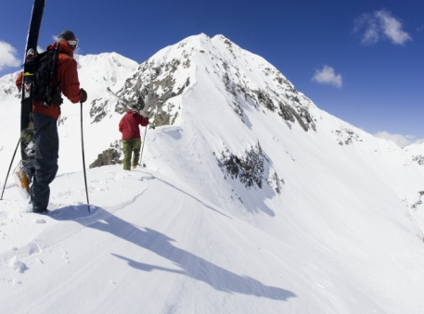
Fractals are for Organizations are what snowflakes are for avalanches.

